Slide 1
Data wrangling (tidy + transformation)

Slide 2
Section overview
● Data transformation libraries
● Variables manipulation
● Cases manipulation
● Summarizing and grouping
● Piping
● Pivoting
● Separating and uniting
● Transform and visualize data

Slide 3
Data transformation
● In order to use ggplot2 for data visualization data must be in a form of a “tidy” data.
● Therefore, some data pre-processing or data cleaning is mandatory.
● This section is devoted to refresh your skills on data wrangling.
● We will dive through most essential functions that are part of two selected R packages:
○ dplyr - functions for data wrangling
○ tidyr - functions for creating tidy data
● Both packages were written by Hadley Wickham (ggplot2 creator)!

Slide 4
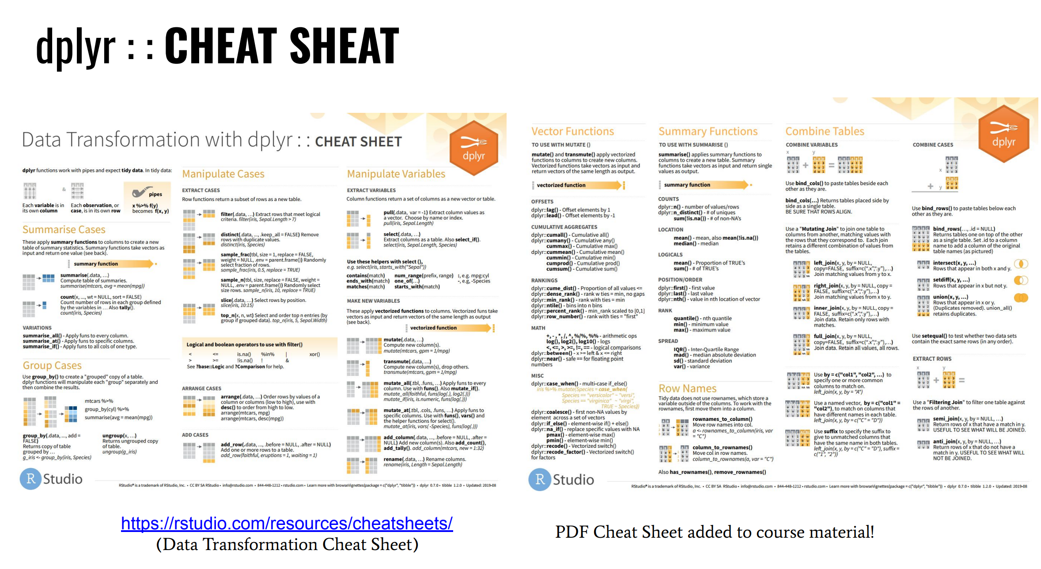

Slide 5
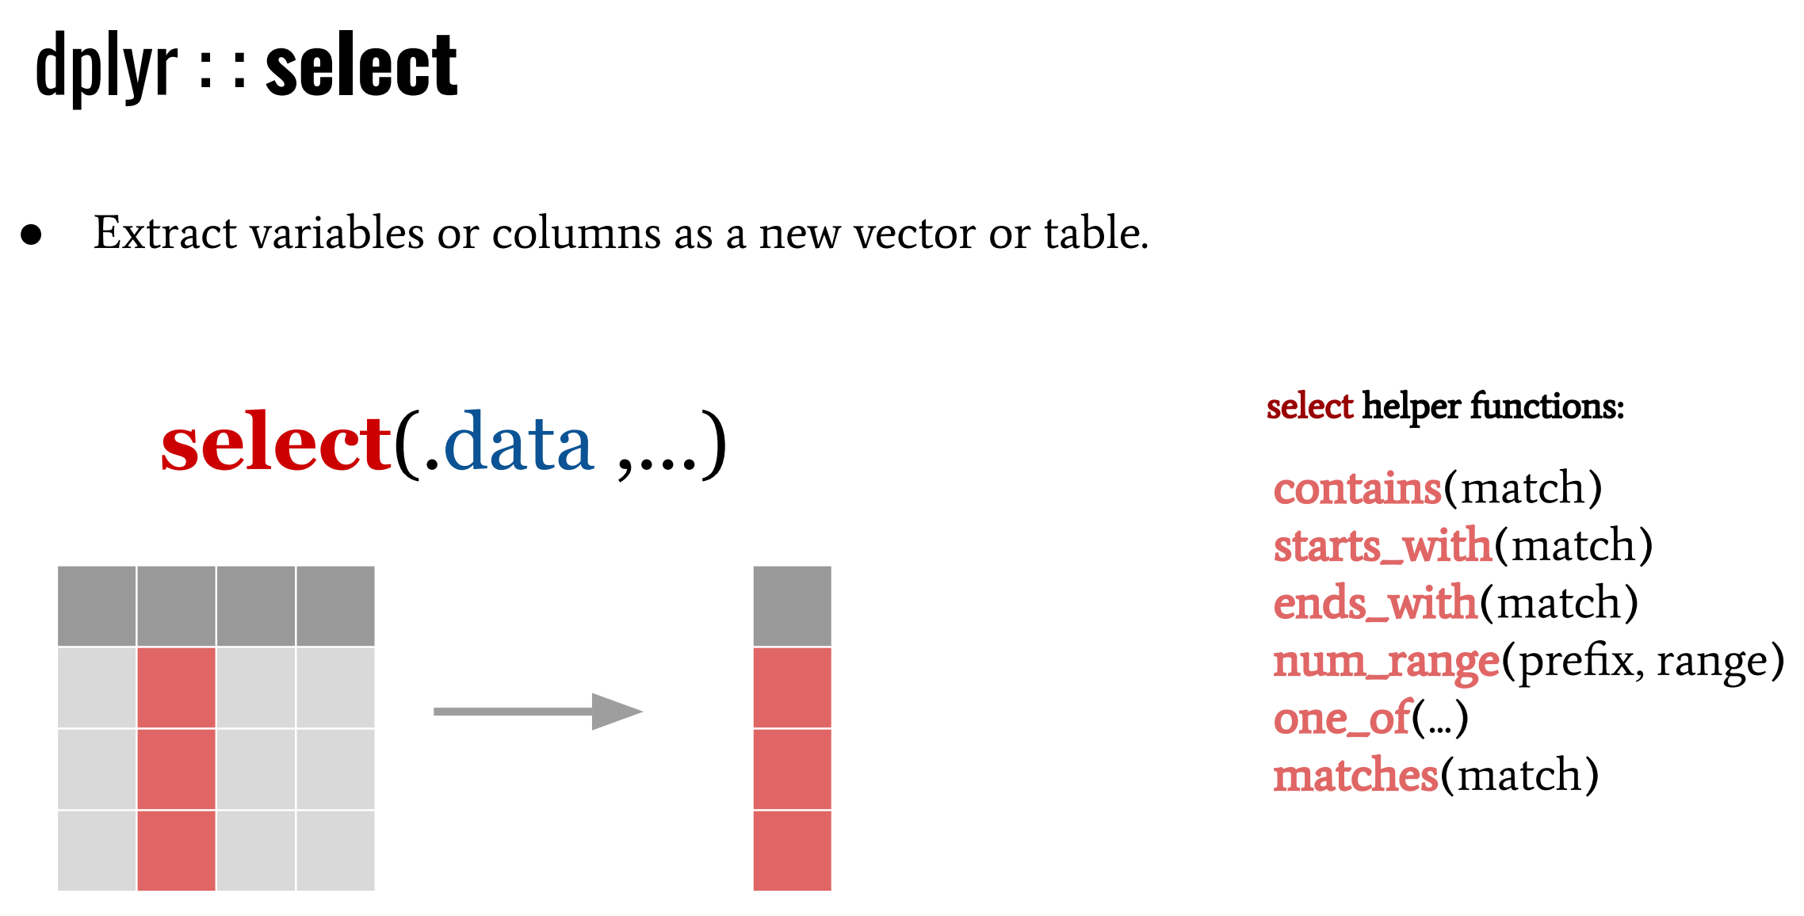
Variables manipulation

Slide 6
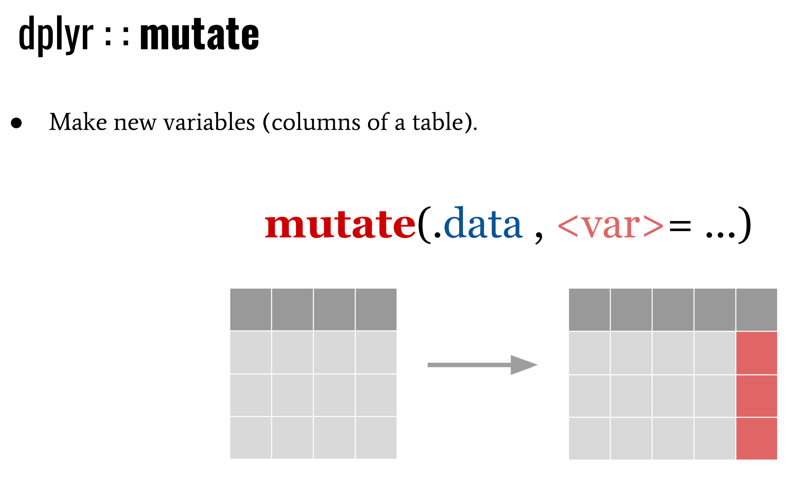

Slide 7
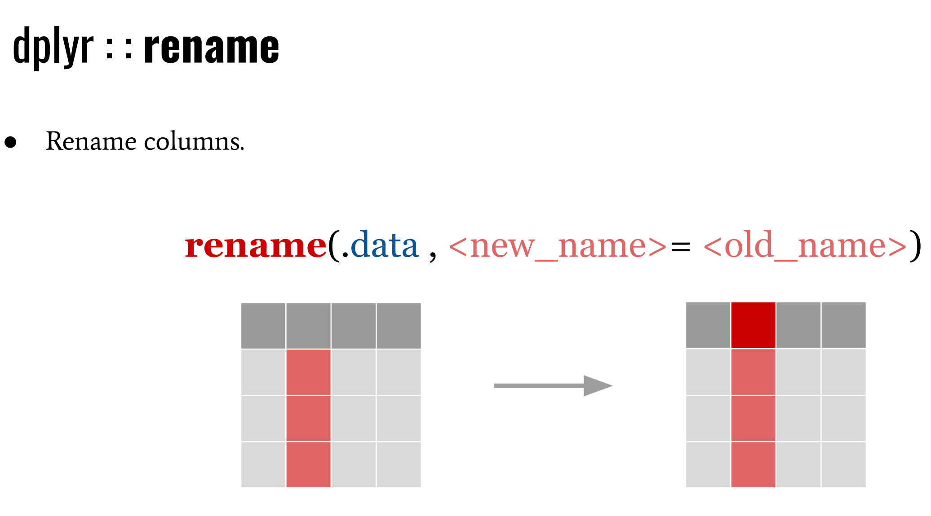

Slide 8
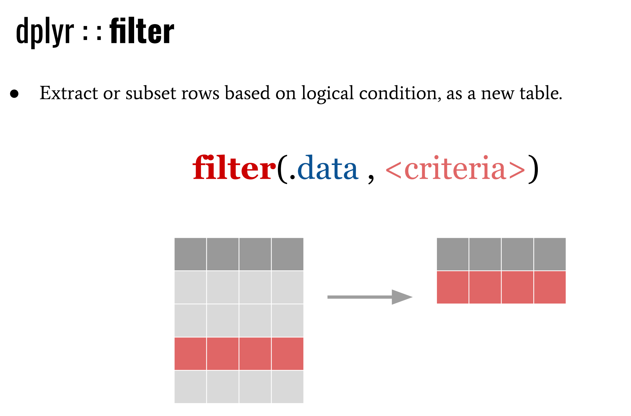
Cases manipulation

Slide 9
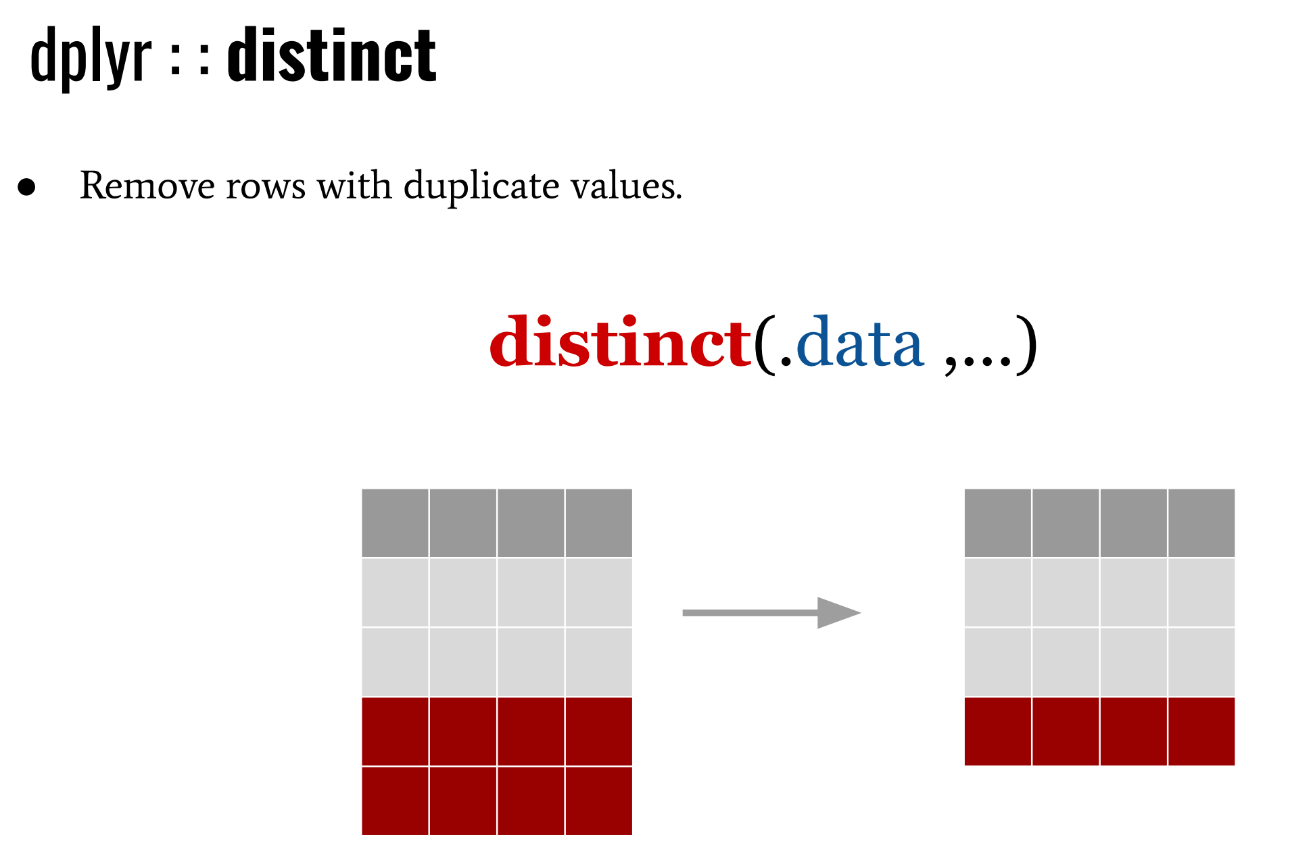

Slide 10
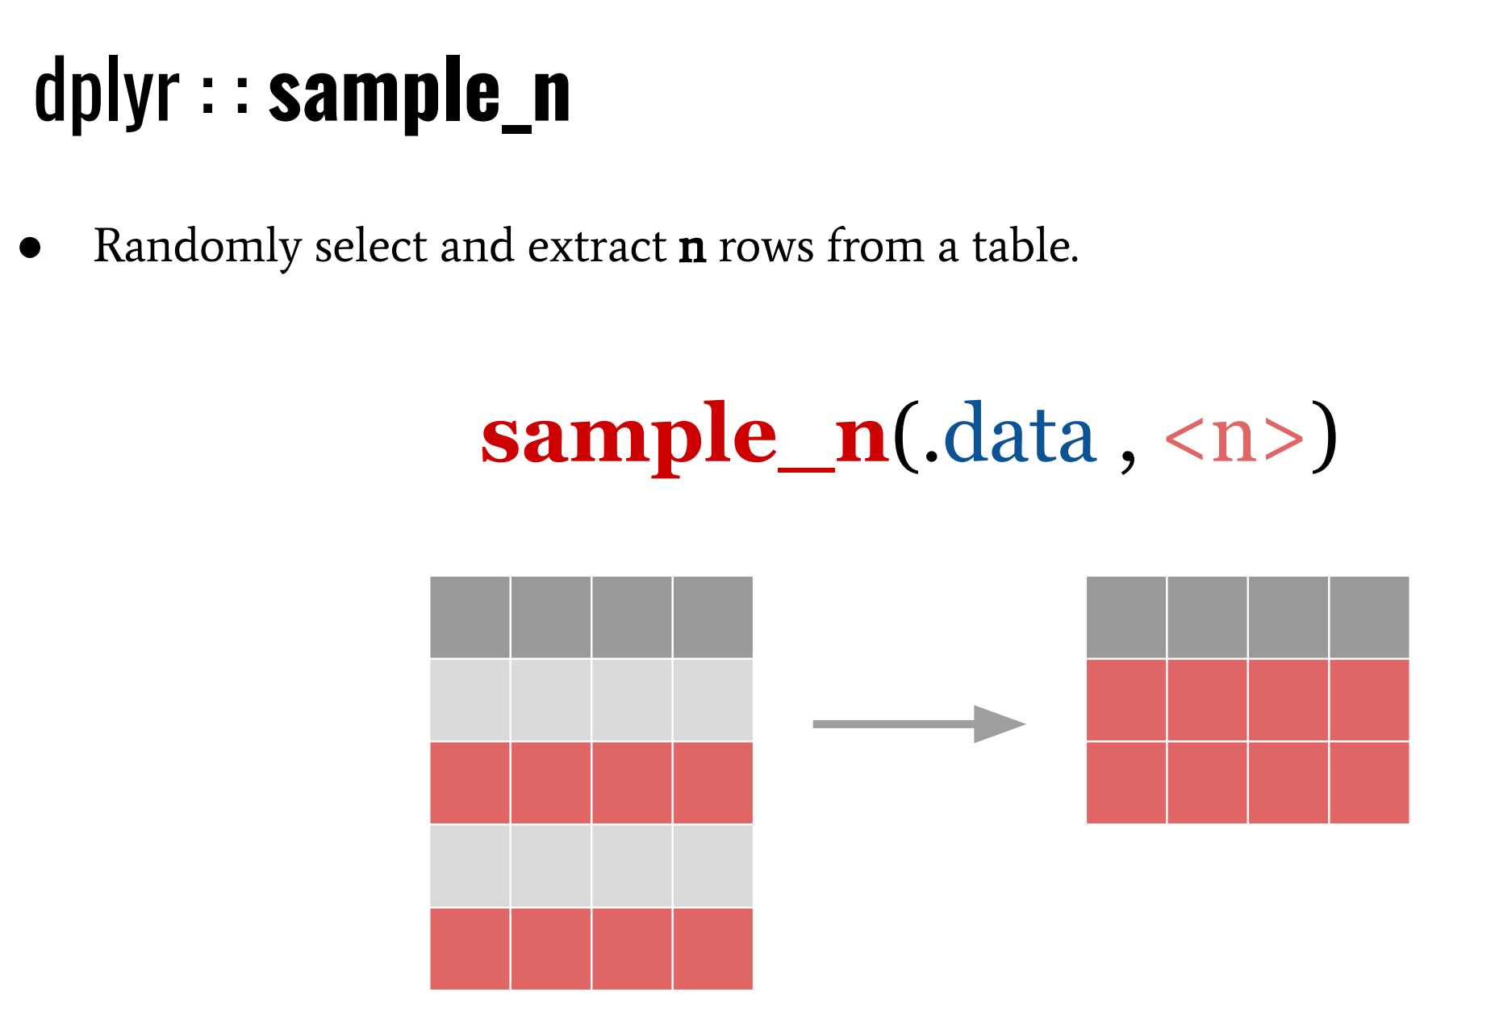

Slide 11
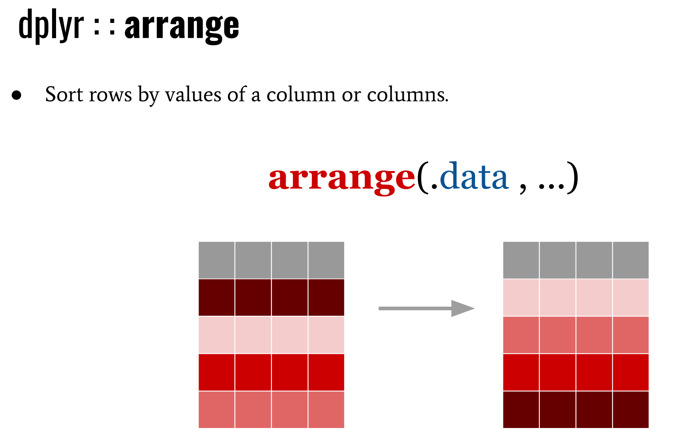

Slide 12
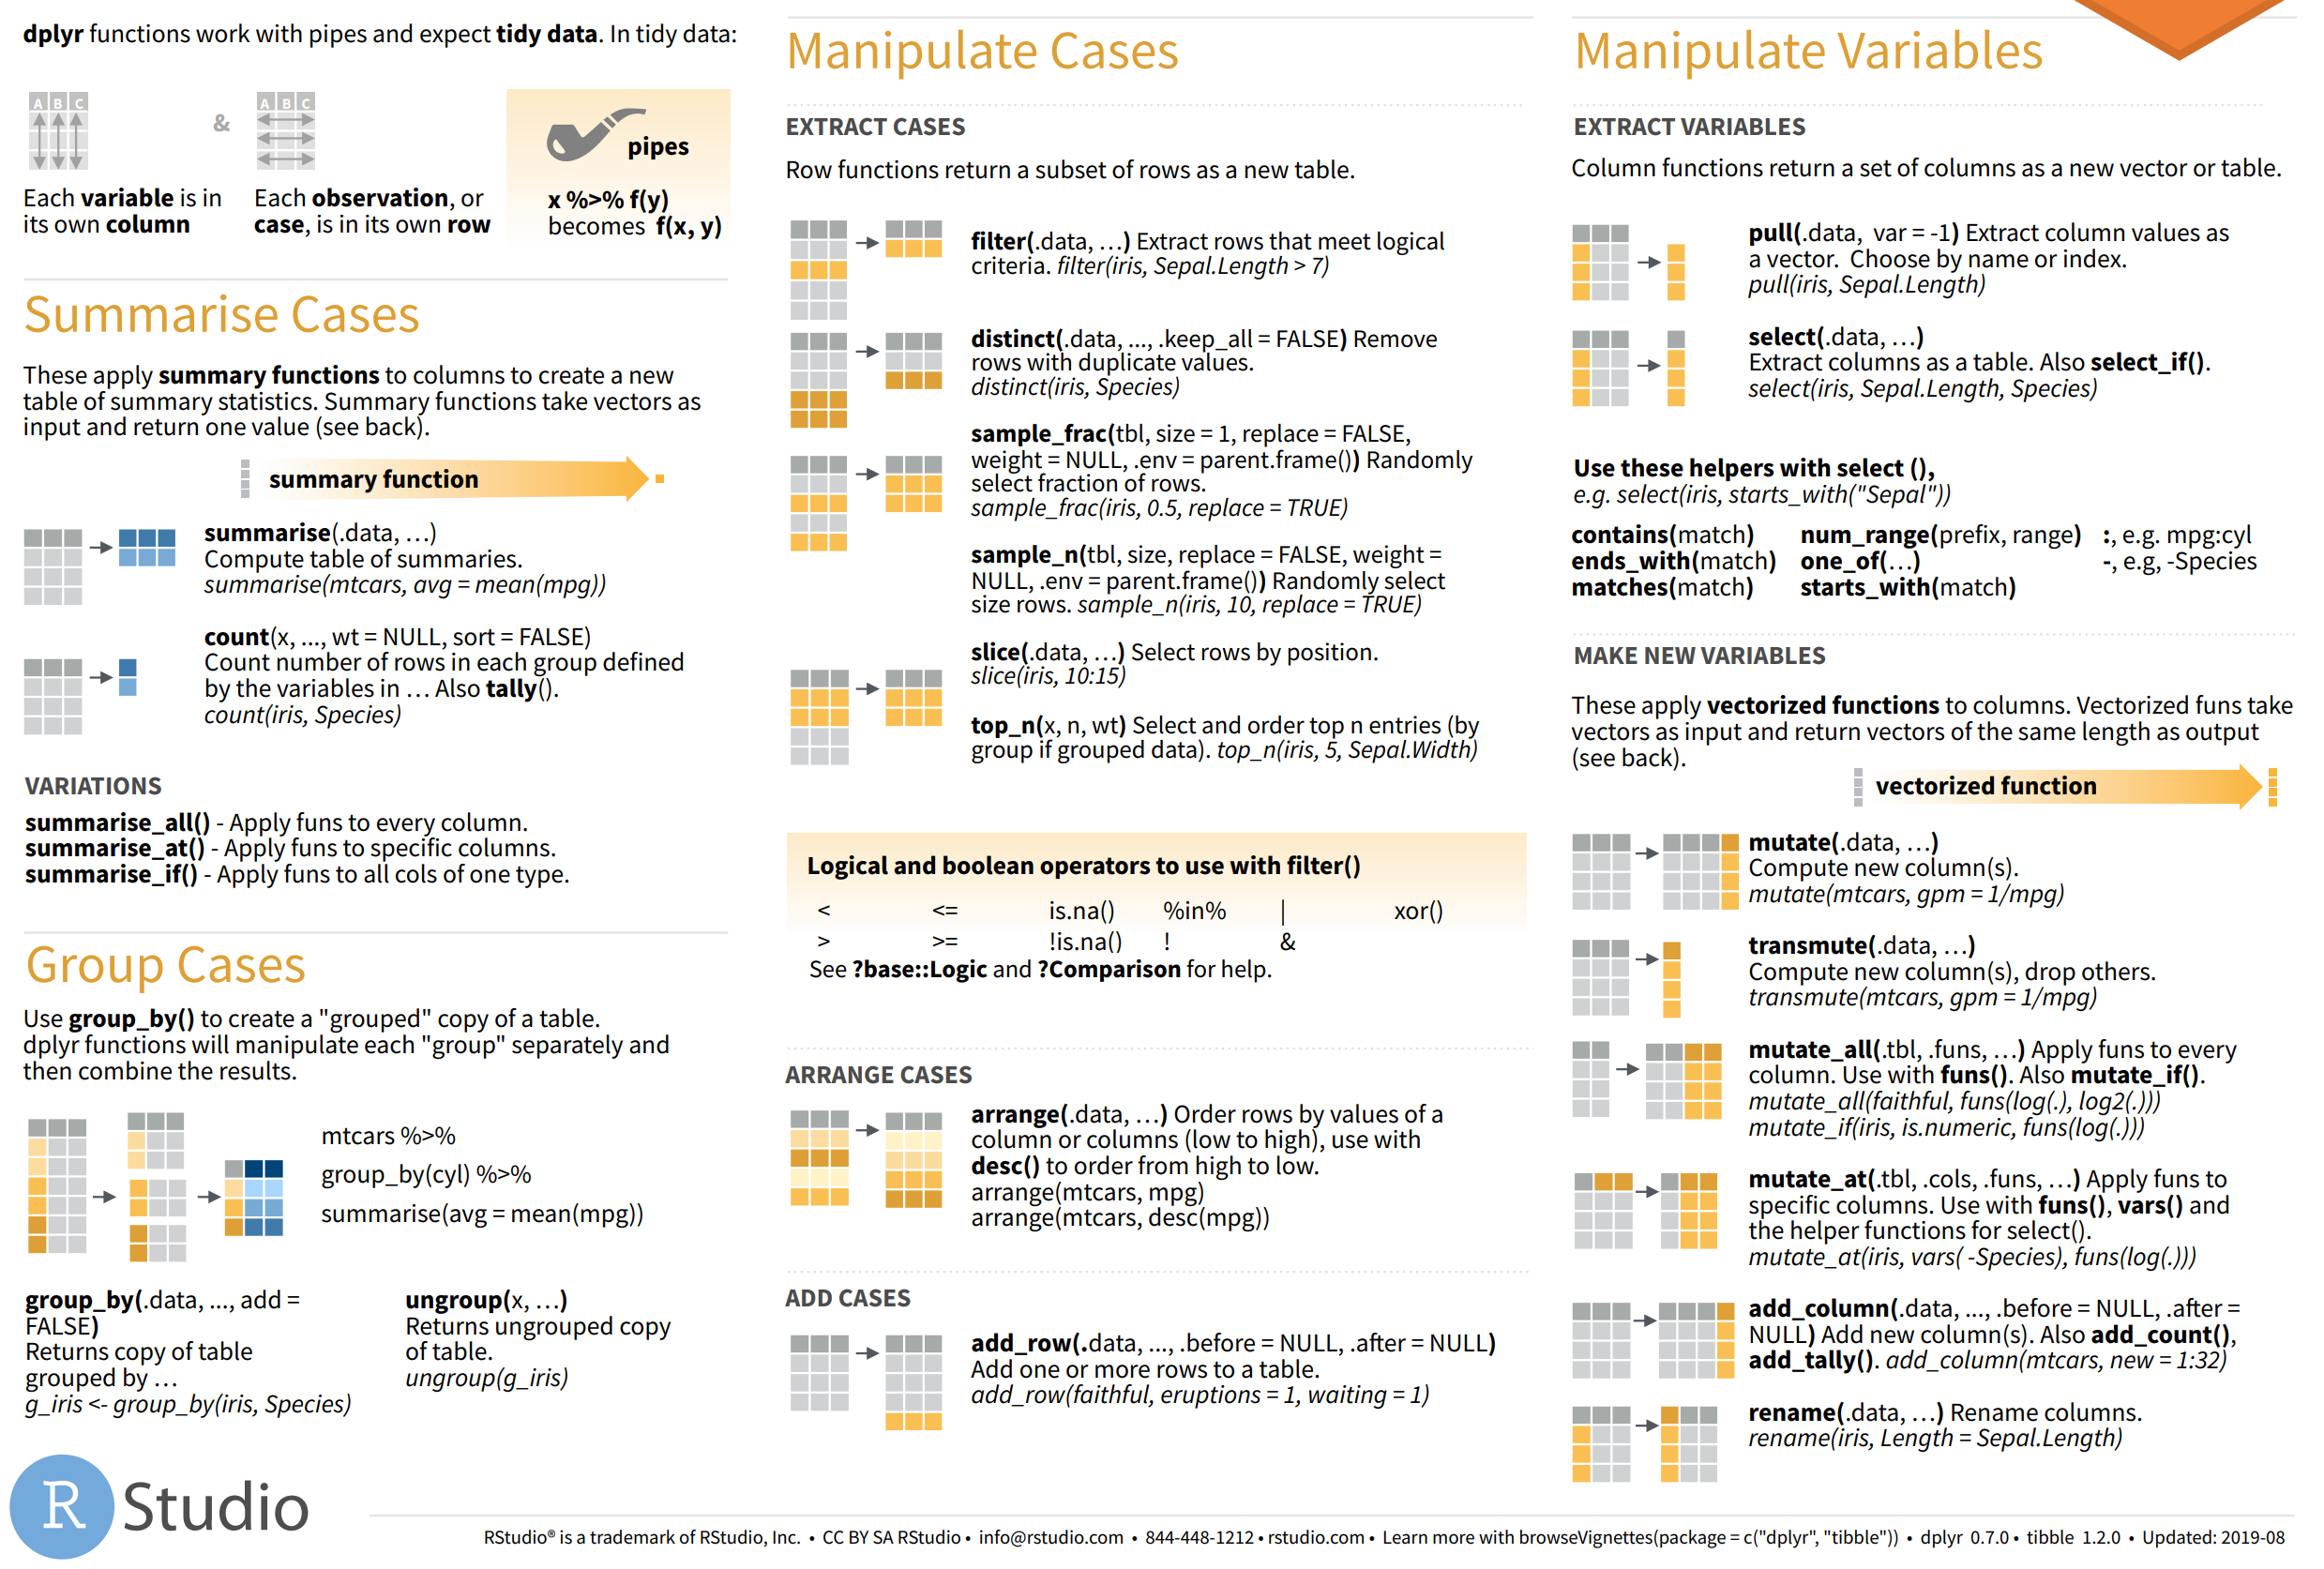
SCRIPT

Slide 13
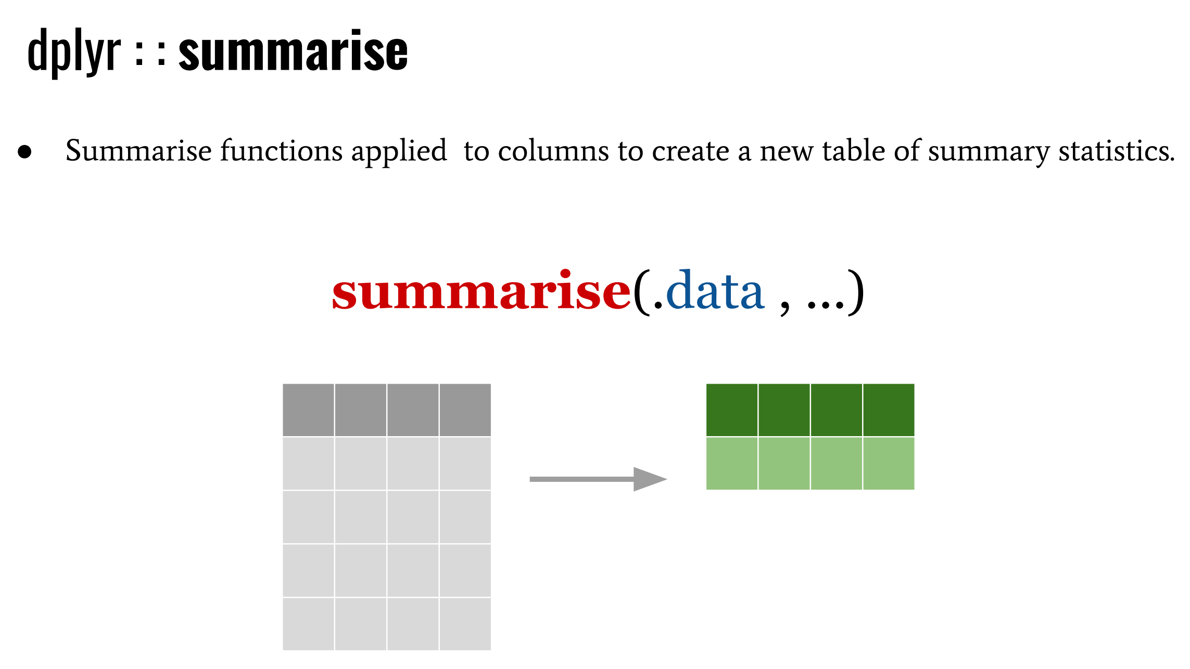
Summarizing & Grouping

Slide 14
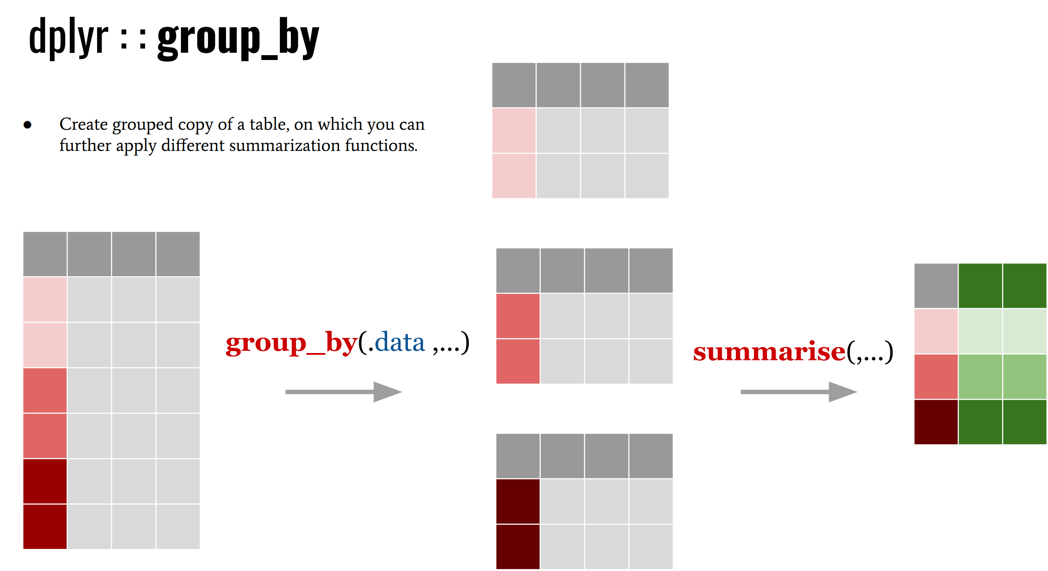
Grouping
SCRIPT

Slide 15
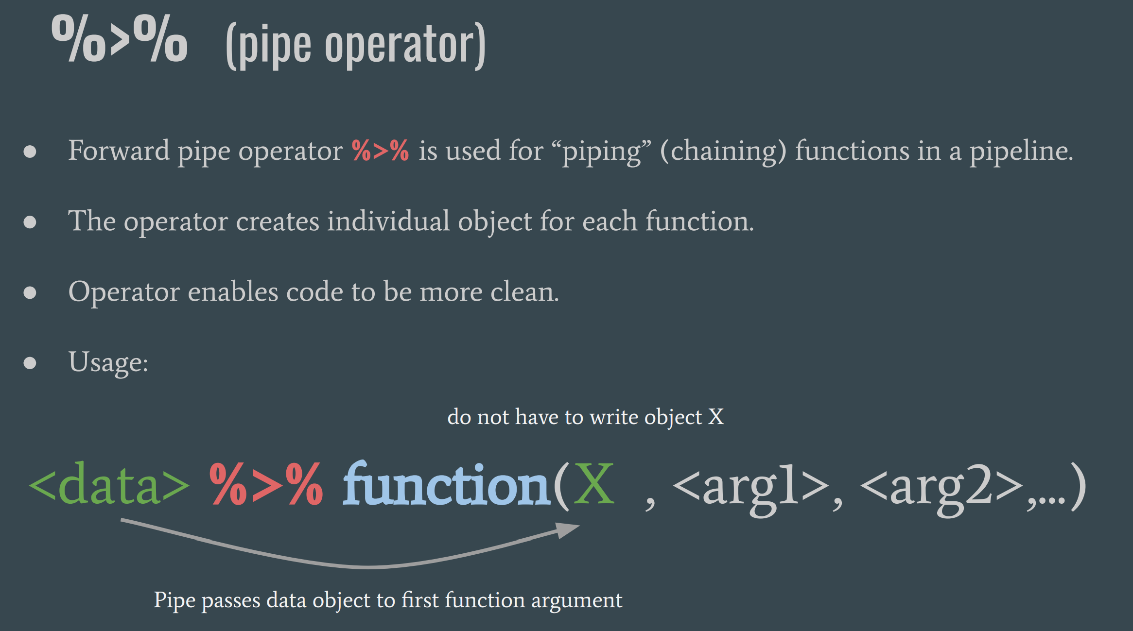
Piping

Slide 16
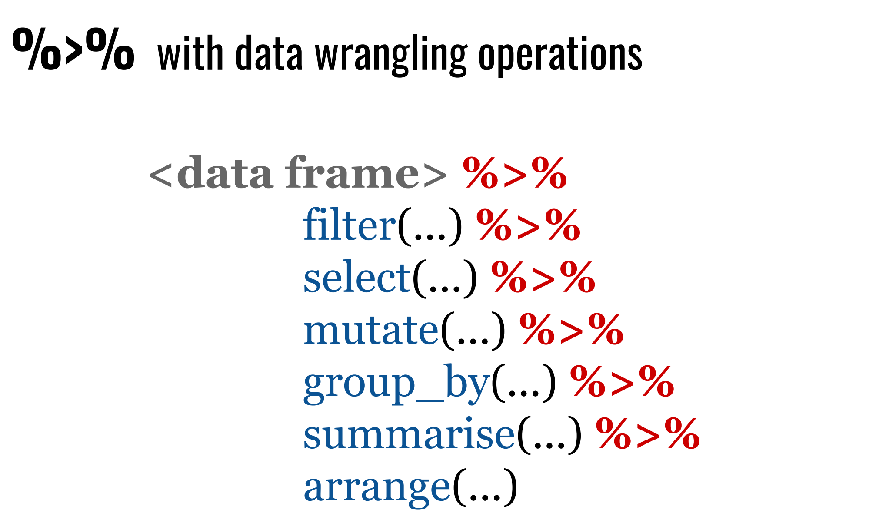
SCRIPT

Slide 17
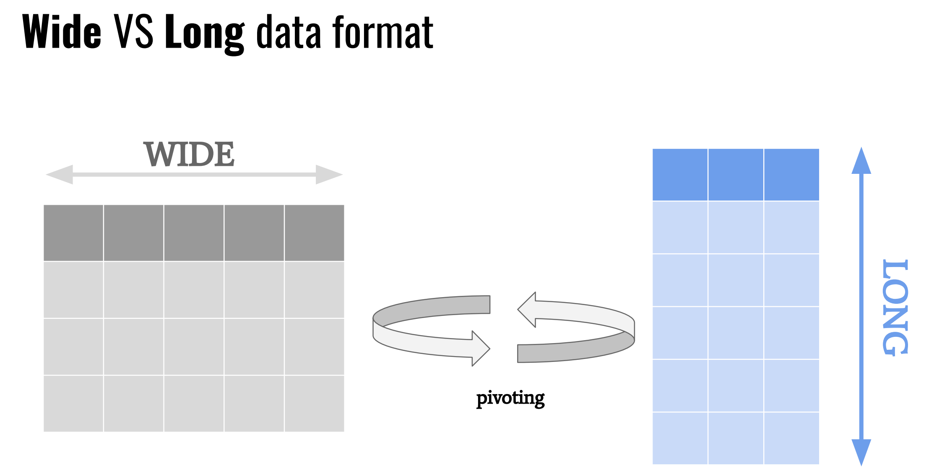
Pivoting

Slide 18
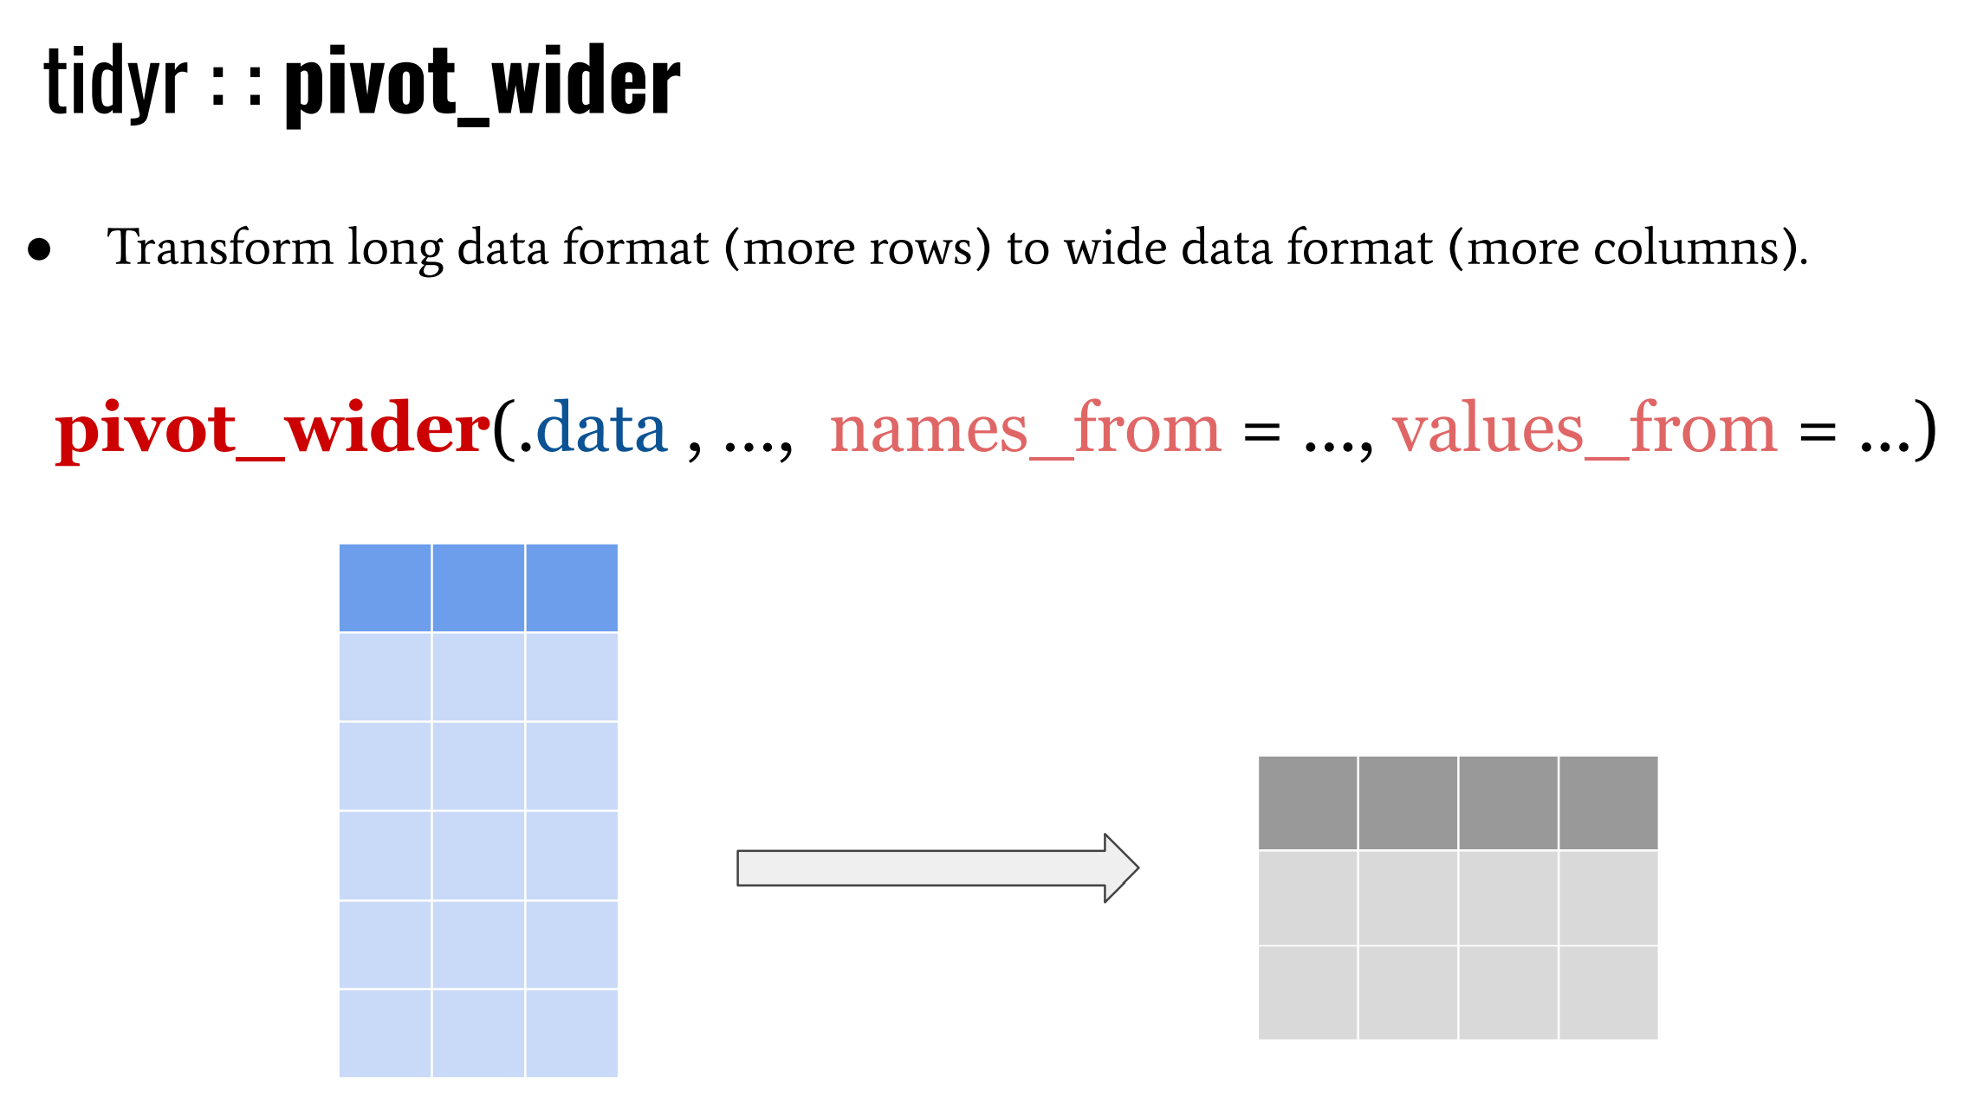
SCRIPT

Slide 19
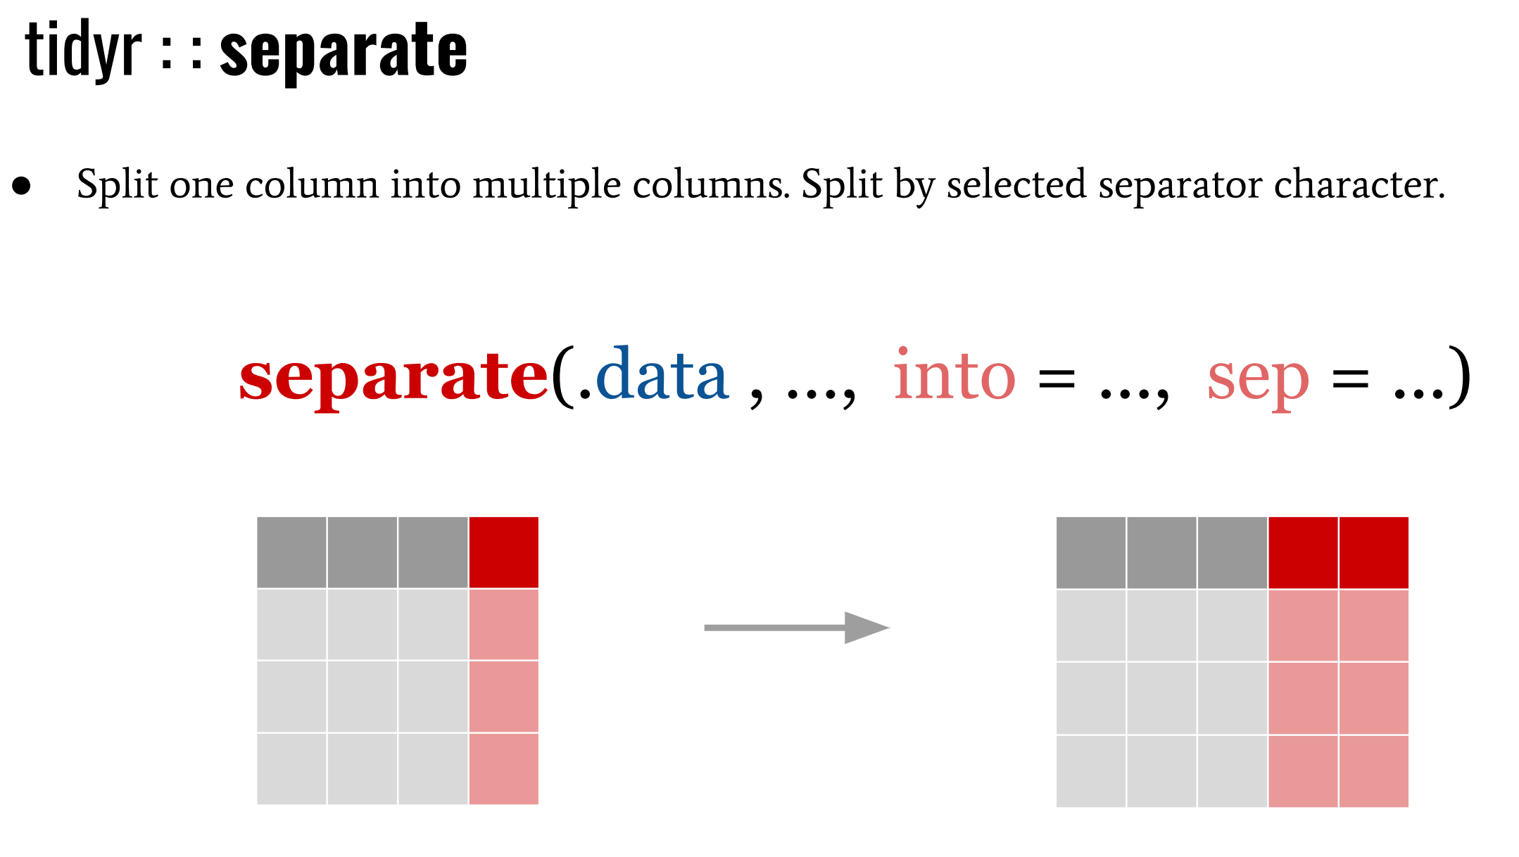
Separating & uniting

Slide 20
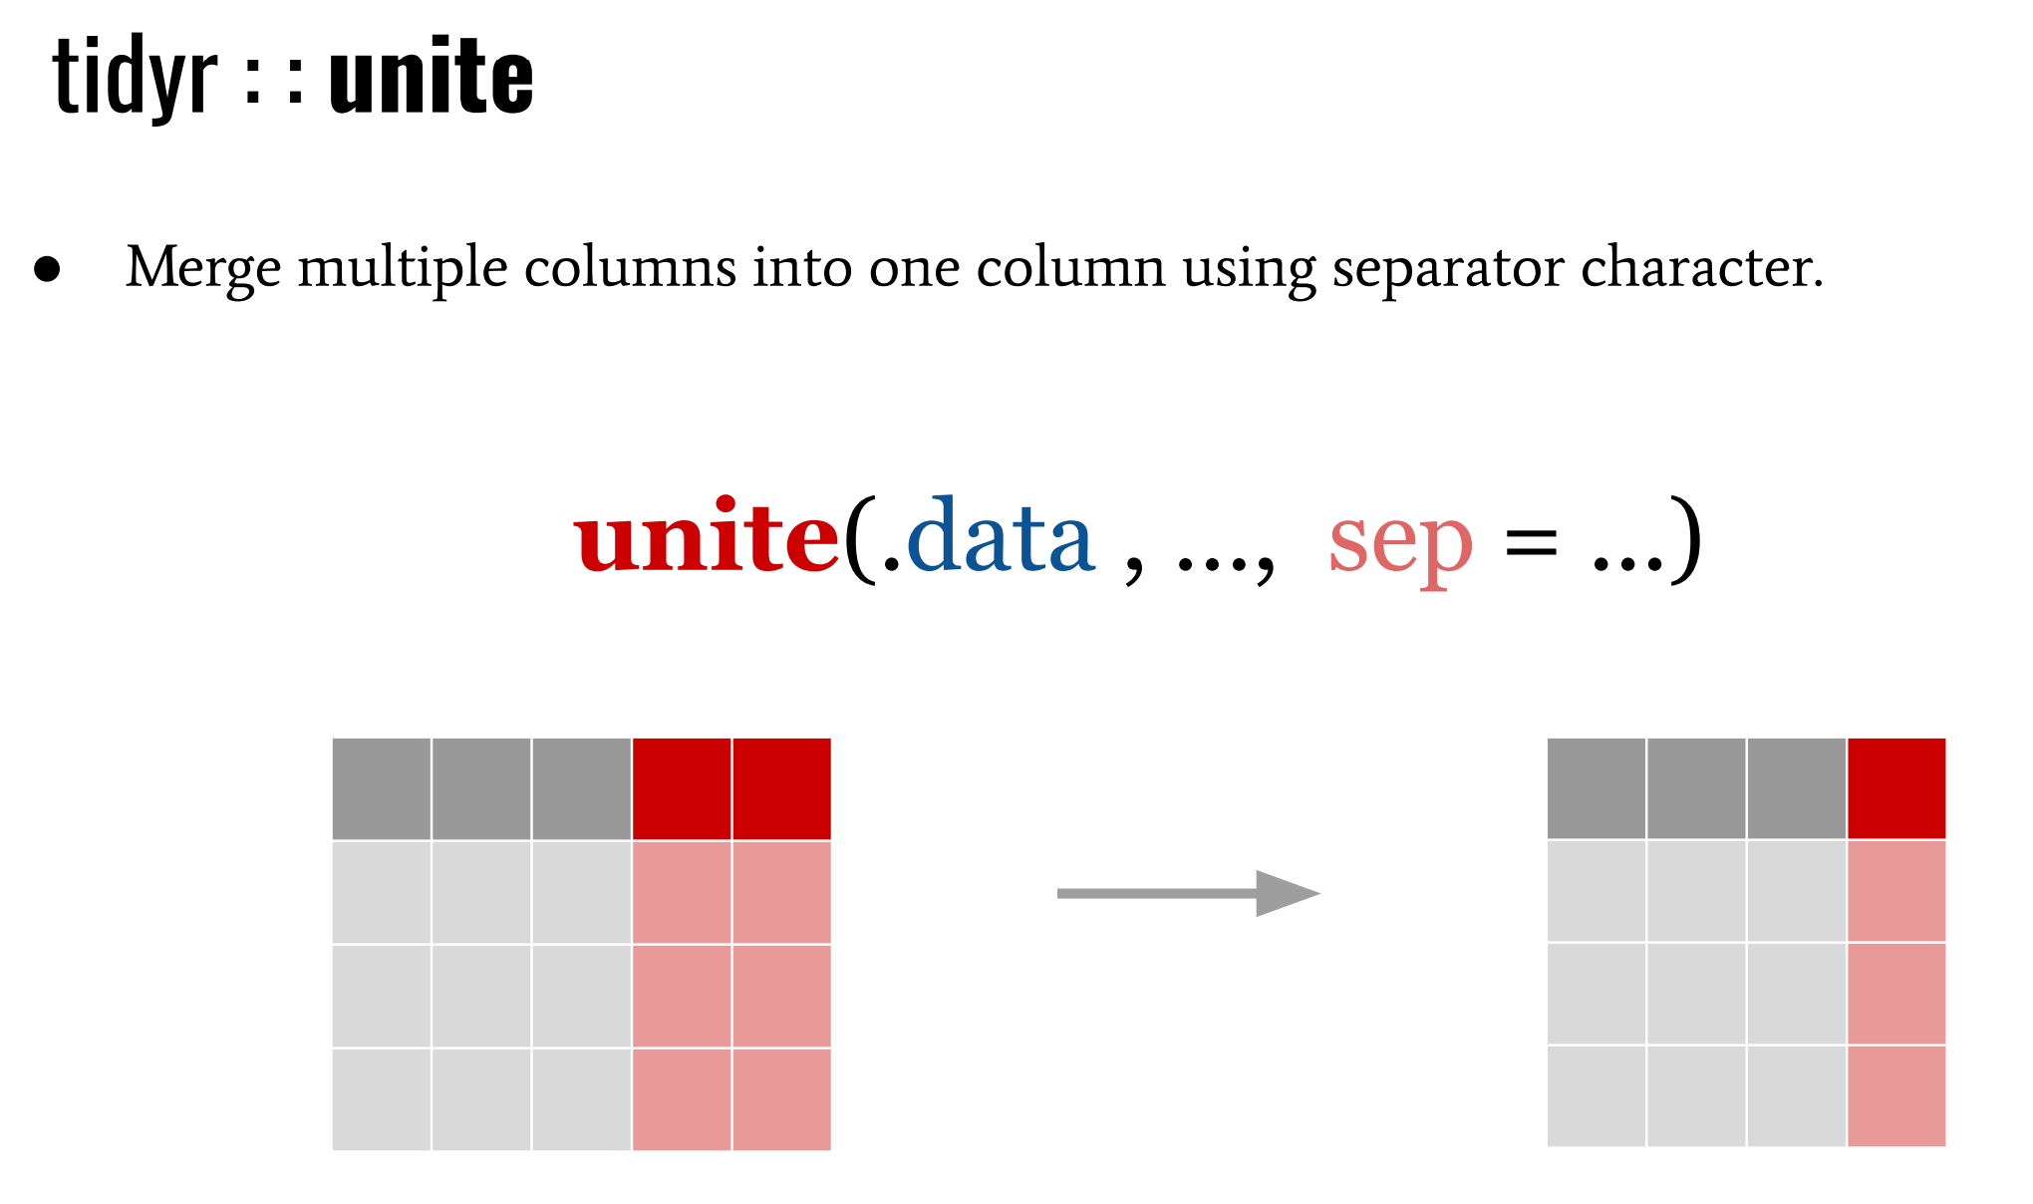
SCRIPT

